Slide 1














Valuebound
The Dependable Partner in your Digital Transformation Journey

Slide 2






About Valuebound
Founded in 2008, a professionally managed, rapidly growing Digital Experience company actively involved in transforming ideas into products and solution, extending our services to enable businesses create long lasting digital impression.
$30+
94%
7+
100%
Billion in Revenue Impact
Client Retention Rate
Countries Global influence
Strong Technology Team
Empowering clients with transformative solutions that have impacted revenue of $38 billion.
With our customer centric approach, we have been able to retain 94% of our enterprise accounts
Our reach spans continents, fostering a diverse and adaptable partnership ecosystem for global success.
We spend 8% of our revenue in technical upscaling of our resources.
valuebound.com

Slide 3
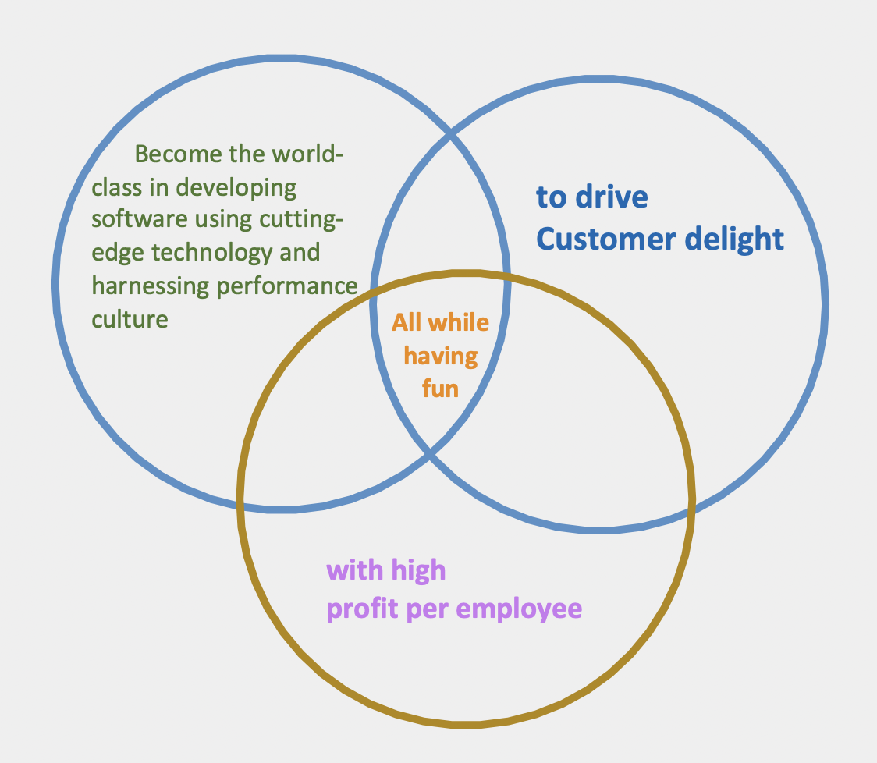
Our Vision & Values
Empathy:
Compassionately connecting with you, understanding your needs and exceeding expectations.
Customer Delight:
Every interaction is a chance to create experience with thoughtful service. We work towards achieving our customer's objective on time and with quality.
Continuous Learning:
Fueling growth with a relentless pursuit of increased knowledge of every team member and innovation.
Integrity:
Integrity in our business ethos means a steadfast commitment to delivering on our promises.

Slide 4














Our Offerings
Services
Wordpress
AWS
Enterprise
Website Services
Digital Experiences
AWS Services
Platform
Moodle
Drupal
sitecore
Salesforce
UI UX Services
Migration & Modernization
Managed Services
valuebound.com

Slide 5











Tech Partnerships
Business Partnerships
Certifications
ISO/IEC 27001:2022 &
ISO 9001:2015 certified
Good Firms
valuebound.com

Slide 6
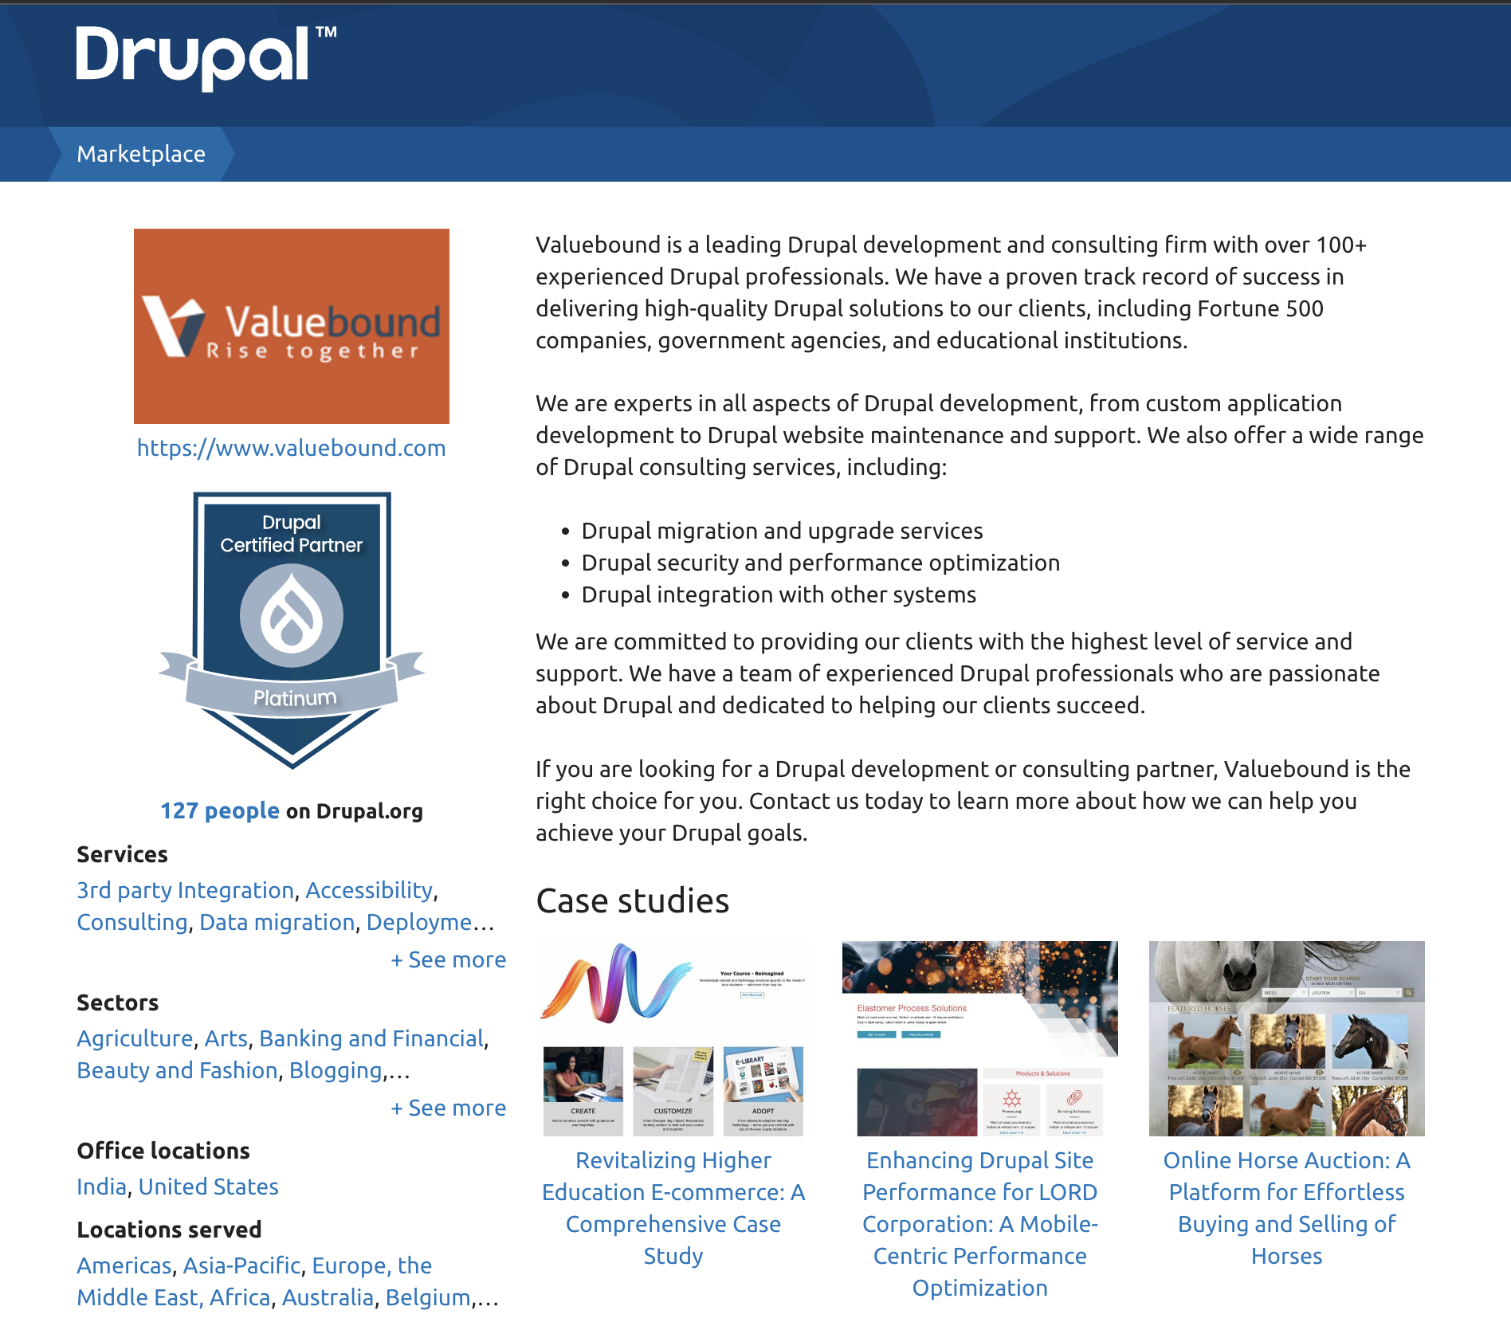

Drupal Expertise
Development & Customization
Expertly build and customize websites and applications that our partners depend on.
Managed Services
Keep your website secure, up-to-date, and running smoothly with 24/7 support.
Migration and Update
Migrate or upgrade your CMS with confidence, knowing that your business continuity is our top priority.
valuebound.com

